Slide 1
Community connections
Team Members:

Slide 2
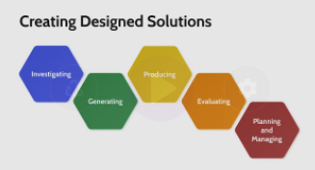
Community connections
Design Brief - Welcome to Community Connections
We have all experienced significant challenges in recent years, and Community Connections is an opportunity to re-establish the important connections we have to our communities wherever and whatever they may be.
Collaboratively you will explore the significant elements of, and connections within, your communities. You will focus on a specific audience and build a digital product on a platform of your choice that reflects your communities in ways that others can share and connect to.
Design Brief
Read the design brief and identify key information in the space provided below.
Key Information:
Help Video: Planning and Managing

Slide 3
Community connections
Evaluate
Produce
Generate
Investigate
Seek feedback from your audience to find ways to create more connections and improvements to your digital content.
Produce your digital content in a way that is intuitive and engaging for your audience to interact with.
Generate a range of concepts for expressing elements of your communities in a digital platform.
Explore your communities and identify the different elements that make them unique.
Help Video: Design Process

Slide 4
Community connections
Community Elements
Investigate
List all of the possible community connections you could make with your digital product.
Your communities may only have some or all of these connections.
Geographical Connections
Social Connections
Indigenous
Connections
Historical Connections
Cultural Connections
Help Video: Investigate

Slide 5
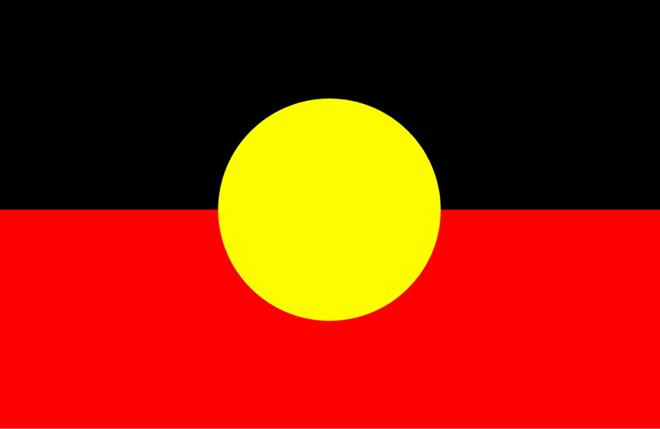
Community connections
Australian Indigenous Design Charter
AIDC:CD
1) Indigenous led. Ensure Indigenous representation creation in design practice is Indigenous led.
2) Self-determined. Respect for the rights of Indigenous peoples to oversee representation creation of their culture in design practice.
3) Community specific. Ensure respect for the diversity of Aboriginal and Torres Strait Islander culture by following community specific cultural protocols.
4) Deep listening. Ensure respectful, culturally specific, personal engagement behaviors for effective communication and courteous interaction are practiced.
5) Impact of design. Always consider the reception and implications of all designs so that they are respectful to Indigenous culture.
6) Indigenous knowledge. Respectfully ask the client if there is an aspect to the project, in relation to any design brief, that may be improved with Indigenous knowledge.
7) Shared knowledge (collaboration, co-creation, procurement). Develop and implement respectful methods for all levels of engagement and sharing of Indigenous knowledge (collaboration, co-creation, procurement).
8) Legal and moral. Demonstrate respect and honour cultural ownership and intellectual property rights, including moral rights, and obtain appropriate permissions where required.
9) Reconciliation Action Plan (RAP). Develop a RAP incorporating the AIDC:CD.
10) Charter implementation. Ensure the implementation of the AIDC:CD to safeguard Indigenous design integrity
Investigate
Every community in Australia should connect to Indigenous culture and First Nations people.
Here is some advice for design professionals that may be helpful.
The Australian Indigenous Design Charter: Communication Design (AIDC:CD) was created to guide governments, professional design associations, professional design practitioners and buyers of indigenous design.
When working on projects involving the representation of Aboriginal and Torres Strait Islander culture communication, designers are expected to adhere to the following ten points.
Discuss how the AIDC:CD guidelines could be addressed in your community design project.
What is the difference between appreciation and appropriation?
AUSTRALIAN INDIGENOUS
DESIGN CHARTER

Slide 6
Community connections
Indigenous Connections
Helpful Connections
Local Indigenous people
Local Indigenous organisations
Koorie Engagement Support Officer (KESOs)
Bunjilaka Cultural Centre at Melbourne Museum
First Peoples – State Relations
Victorian Aboriginal Corporation for Languages
Department of Education and Training
Investigate
What connections can you make to Indigenous culture and First Nations people in your communities?
How will you include Indigenous people in this process?
https://indigenousdesigncharter.com.au/australian-indigenous-design-charter/

Slide 7
Community connections
Social Connections
Investigate
What are the social groups and organisations in your communities?
Help Video: Investigate

Slide 8
Community connections
Geographical Connections
Investigate
What are the important places and landmarks in your communities?
Help Video: Investigate

Slide 9
Community connections
Cultural Connections
Investigate
What are the different cultures that exist in your communities?
Help Video: Investigate

Slide 10
Community connections
Historical Connections
Investigate
What is the known history and significant past of your communities?
Help Video: Investigate

Slide 11
Community connections
Technologies
Investigate
What digital technologies could you use to create and share your digital product?
Animation
Website / App
Combinations
AR / VR
Video
Help Video: Investigate

Slide 12
Community connections
Technologies
Investigate
Explore one potential digital technology and show how it has been used in other contexts.
Help Video: Investigate

Slide 13
Community connections
Digital Technologies continued
Investigate
Explore an alternative digital technology and show how it has been used in other contexts.
Help Video: Investigate

Slide 14
Community connections
Potential audiences
Investigate
Explore the possibilities of different audiences and list how this digital product could be useful for them to connect to.
Existing Community
Children
Indigenous
Community
Other
Visitors

Slide 15
Community connections
Audience Exploration
Investigate
Explore one potential audience and show what they would find to be visually and functionally engaging digital content.
Help Video: Investigate

Slide 16
Community connections
Audience Exploration Continued
Investigate
Explore an additional potential audience and show what they would find to be visually and functionally engaging digital content.
Help Video: Investigate

Slide 17
Community connections
Content Concepts
Generate
What content will you need to create for your digital product?
Help Video: Generate

Slide 18
Community connections
Content Concepts Continued
Generate
What content will you need to create for your digital product?
Help Video: Generate

Slide 19
Community connections
Structural Concepts
Generate
How will you structure your content in your digital product?
Help Video: Generate

Slide 20
Community connections
Structural Concepts Continued
Generate
How will you structure your content in your digital product?
Help Video: Generate

Slide 21
Community connections
Interface Concepts
Generate
What will the digital interface look like for your chosen audience?
Help Video: Generate

Slide 22
Community connections
Interface Concepts Continued
Generate
What will the digital interface look like for your chosen audience?
Help Video: Generate

Slide 23
Community connections
Content Required
Production
How will you create the required content?
Help Video: Produce

Slide 24
Community connections
Indigenous Consultation
Production
How will you include indigenous consultation and/or collaboration?
Help Video: Produce

Slide 25
Community connections
Technology Required
Production
How will you learn / use the required digital technology?
Help Video: Produce

Slide 26
Community connections
Storyboard Concepts
Production
Create a visual representation of how your content will be presented.
Help Video: Produce

Slide 27
Community connections
Timeline and Responsibilities
Production
How will you create all of the elements and final digital product in time?
Help Video: Produce

Slide 28
Community connections
Audience Feedback
Evaluation
How will you capture feedback from your chosen audience?
What questions will you ask?
Feedback Questions | Summary of Responses
Help Video: Evaluate

Slide 29
Community connections
Indigenous Inclusion
Evaluation
How will you capture feedback from the connected indigenous community?
What questions will you ask?
Feedback Questions | Summary of Responses

Slide 30
Community connections
Suggestions for Improvement
Evaluation
What key feedback would you be able to respond to in your digital product?
Key Feedback Suggestions | Actions for Improvement
Help Video: Evaluate

