Slide 1
Introduction to Design

Slide 2
Welcome to Design and Technologies!
Some of you may already know what this subject is about but there are probably some of you that don’t…
So, let’s start at the very beginning and think about -
What is Design?

Slide 3
Don’t forget - this image means ‘complete this slide!’
In the space below, use your own words to describe what YOU think DESIGN is?

Slide 4
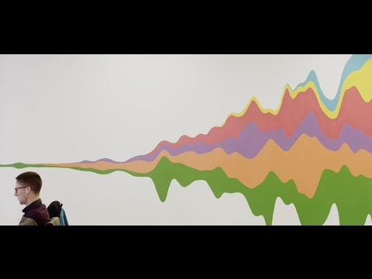
WATCH ME!

Slide 5
“Design is the ability to amend the imperfect.”
“Design is knowing what questions to ask and how to ask them.”
Design is a way to understand the world and how you can change it.
Design is Problem Solving!
Design is all around us, from the mug you drink from, to the handle on the car door. From the underwear you are wearing, to the fork you use to eat your food!
From the button you press at the traffic lights to change the light, to the building you call your school!
Design is EVERYWHERE! Look around you...
READ ME!

Slide 6
Watch the video on the next slide, and use the design language, to complete the tasks that follow!

Slide 7
WATCH ME!

Slide 8
READ ME!
Task: The following slides require you to put your thinking cap on and really think about why certain things have been designed the way they have, and for what types of people they have been designed for!
The NEXT slide is an example of how you are required to complete the slides! REMEMBER to use the elements and principles of design when describing the products!
Make sure to complete all the slides before submitting your work for HAND-IN.
What you need:
iPad - to take photos
Your thinking cap (you’re more than welcome to put on a physical cap while you are doing this task!)

Slide 9
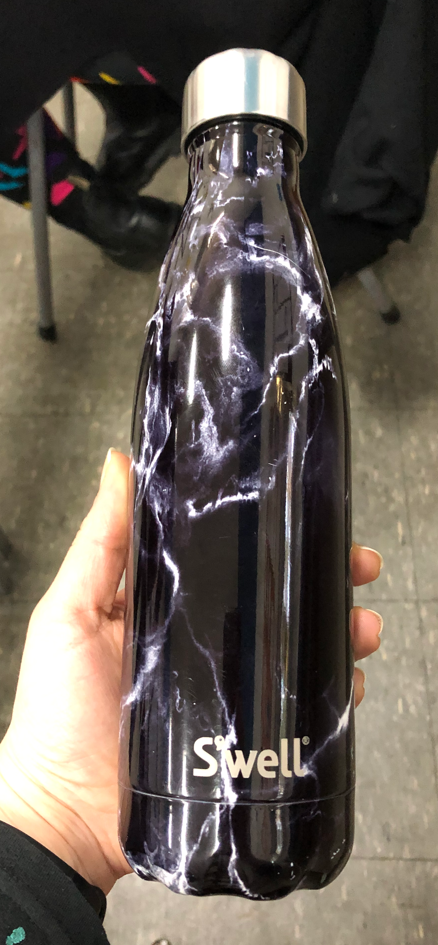
Teacher Example
Find an object around your house that:
Is used to hold hot liquid.
3. Describe below why the design of this object meets the above function/purpose:
This ‘Swell’ bottle holds hot and cold liquids for up to 12 hours.
The bottle is made out of stainless steel which allows for the heat to be kept inside the vessel for a prolonged amount of time.
The lid has rubber on the inside that can be screwed closed to hold the liquid inside the vessel without spilling/dripping.

Slide 10
Task #1
Find an object around your house/school that:
Is used for stirring or scooping.
2. Take a photo of this object and paste it into this box.
3. Describe below why the design of this object meets the above function/purpose:

Slide 11
Task #2
Find an object that:
Can protect a body part(s)
2. Take a photo of this object and paste it into this box.
3. Describe below why the design of this object meets the above function/purpose:

Slide 12
Task #3
Find an object that:
Attracts a person’s attention.
2. Take a photo of this object and paste it into this box.
3. Describe below why the design of this object meets the above function/purpose:

Slide 13
Task #4
Find an object that:
Is made for a child to use.
2. Take a photo of this object and paste it into this box.
3. Describe below why the design of this object meets the above function/purpose:

Slide 14
Task #5
Find an object that:
Can be held comfortably with one hand.
2. Take a photo of this object and paste it into this box.
3. Describe below why the design of this object meets the above function/purpose:

Slide 15
Task #6
Find an object that:
Is used to hold lots of smaller objects.
2. Take a photo of this object and paste it into this box.
3. Describe below why the design of this object meets the above function/purpose:

Slide 16
Task #7
Find an object that:
Has a rough texture.
2. Take a photo of this object and paste it into this box.
3. Describe below why the design of this object meets the above function/purpose:

Slide 17
Task #8
Find an object that:
Has a shiny, smooth texture.
2. Take a photo of this object and paste it into this box.
3. Describe below why the design of this object meets the above function/purpose:

Slide 18
Task #9
Find an object that:
Is your favourite product.
2. Take a photo of this object and paste it into this box.
3. Describe below why the design of this object meets the above function/purpose:

Slide 19
Task #10
Find an object that:
Is very creative/innovative.
2. Take a photo of this object and paste it into this box.
3. Describe below why the design of this object meets the above function/purpose:

Slide 20
Now that you’ve broadened your understanding of design, describe below what YOU think DESIGN is?

Slide 21
WATCH ME!
COMPLETE!
In summary explain why design matters?

Slide 22
It’s a wrap!!
READ ME!
Think you are finished?
Double check your work - have you finished everything? can you add more details?
Well Done!!

