Slide 1
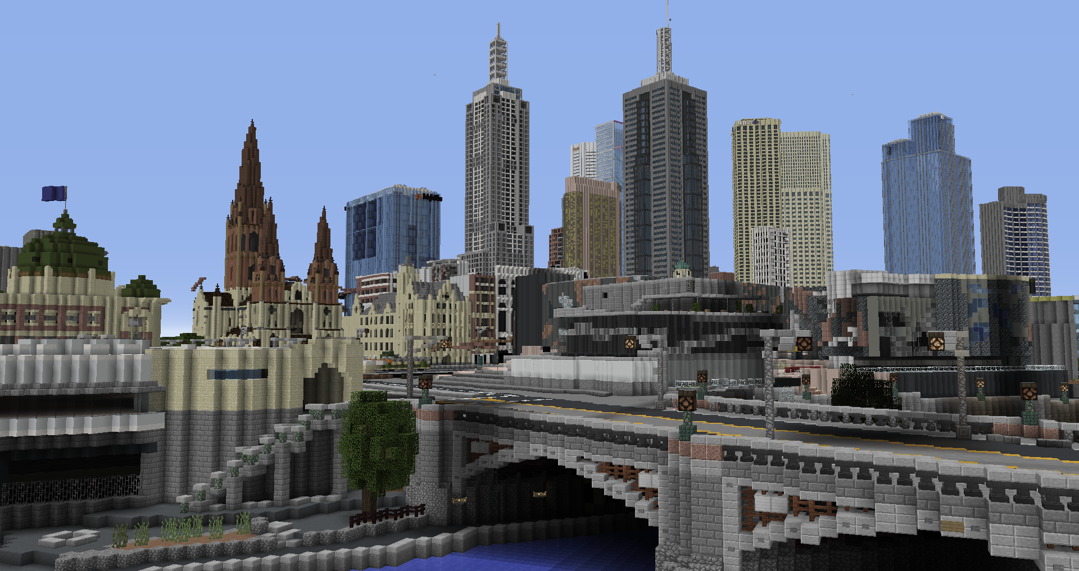
MINECRAFT CITY CHALLENGES: GROW MELBOURNE
DESIGN
MELBOURNE
Team Name:
Team Members:

Slide 2
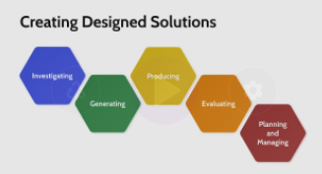
MINECRAFT CITY CHALLENGES: GROW MELBOURNE
Design Brief
Read this design brief and identify key information in the space provided below.
Welcome to Grow Melbourne - A Minecraft Mission!
As cities rapidly increase in population we need to plan for new and more sustainable ways of living.
One key issue that we need to solve is food security, by reducing factors like food miles and other environmental threats.
With climate change increasingly affecting regional areas through fires and floods, we need to consider other ways of providing fresh and nutritious food to help ensure the health and happiness of all the city residents.
We need your help to design Melbourne for a more sustainable future by creating new systems, structures and technologies that will help to achieve this goal.
Key Information:
Help Video:
Planning and Managing

Slide 3
MINECRAFT CITY CHALLENGES: GROW MELBOURNE
Explore the issues around food security and sustainability before looking into Solarpunk concepts that could help you to reshape part of Melbourne.
Generate a range of concepts for improving food security and sustainability of Melbourne through the examples and ideas you discovered in your research.
Identify an area of Melbourne in the Minecraft map for your build. Modify existing structures and layouts to create your designed solution.
Take appropriate screenshots and add them, along with descriptive annotations, to your portfolio.
Seek ongoing feedback from your class, teacher and local school community.
Self-evaluate your Minecraft design and build in your portfolio. Identify pros and cons of your design If you implemented it in real life.
Help Video: Design Process

Slide 4
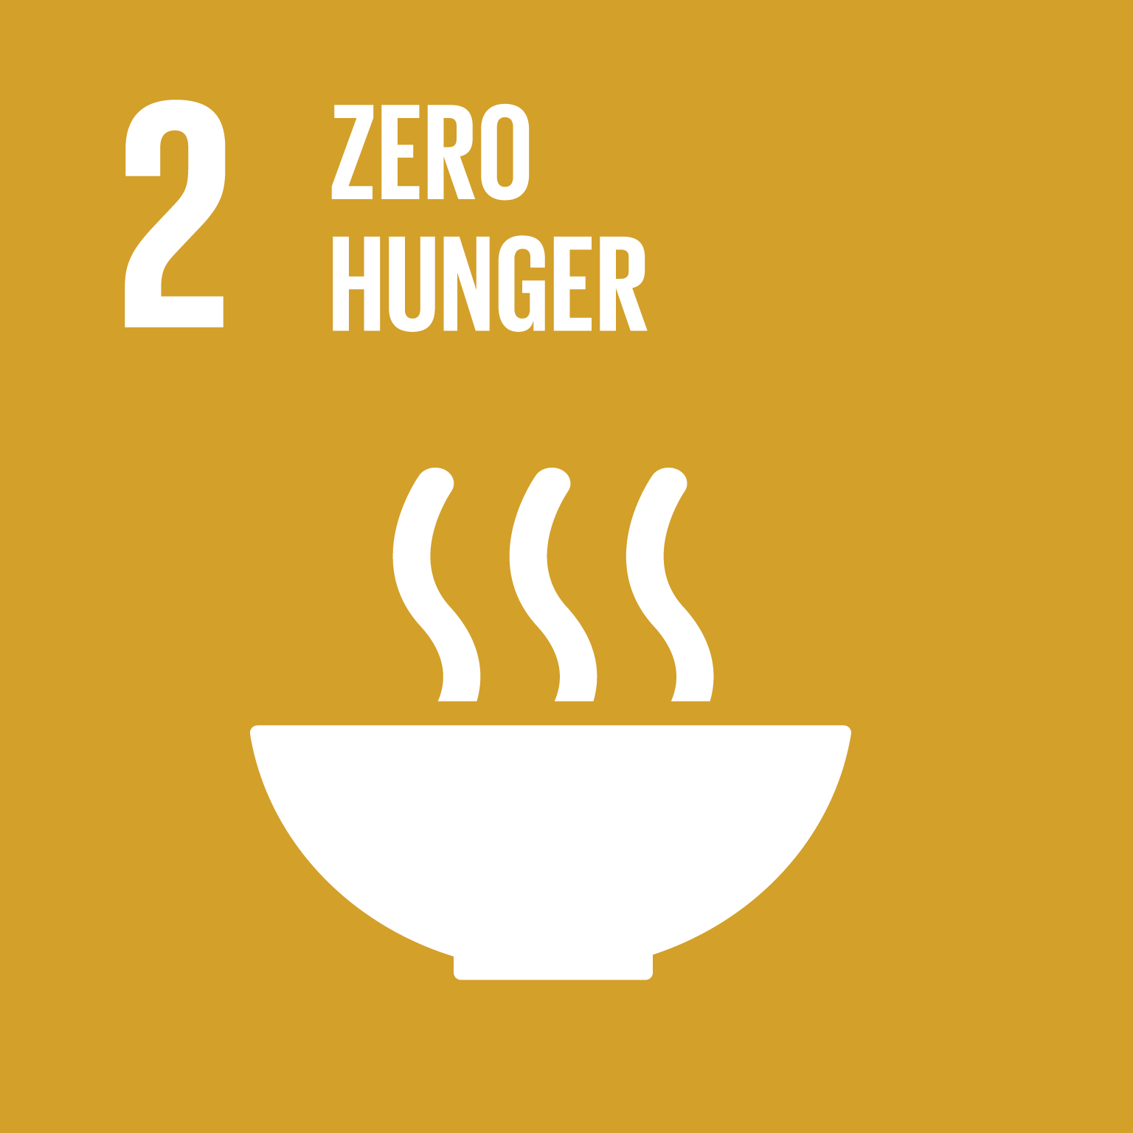
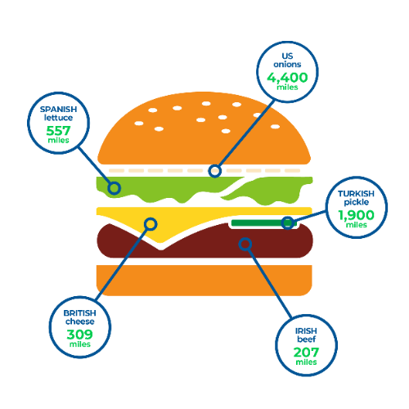
MINECRAFT CITY CHALLENGES: GROW MELBOURNE
Investigate: Food Miles
Problems
Solutions
Research and unpack some of the current food production and distribution issues around the world.
https://www.un.org/sustainabledevelopment/hunger/
https://www.recycle-more.co.uk/blog/recycling-news/food-miles

Slide 5
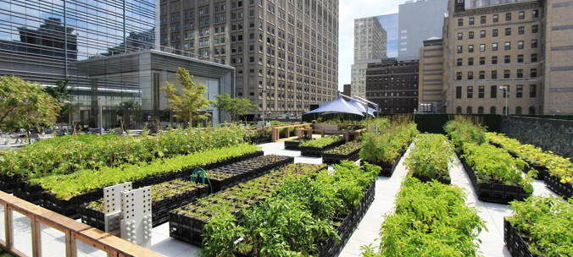
MINECRAFT CITY CHALLENGES: GROW MELBOURNE
Investigate: Urban Agriculture
What is Urban Agriculture?
Examples of Urban Agriculture
Find some examples of ways to grow food in complex urban environments.
Keyword suggestions: urban, agriculture, farm, rooftops, vertical, city
Help Video: Investigate

Slide 6
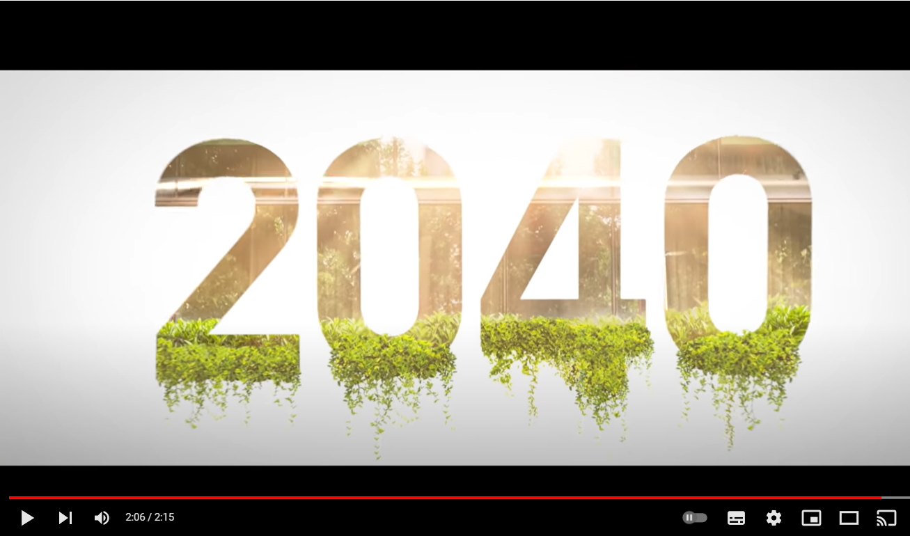
MINECRAFT CITY CHALLENGES: GROW MELBOURNE
Investigate: Solarpunk
Elements of Solarpunk Cities
Explore the concept of Solarpunk and find some new ways of living in futuristic cities that are healthier and more sustainable.
2040 - Official Trailer
https://www.youtube.com/watch?v=p-rTQ443akE

Slide 7
MINECRAFT CITY CHALLENGES: GROW MELBOURNE
Generate: Technologies
Concept sketching: draw lots of quick ideas and annotate them to explain your concepts.
Consider how innovative technologies could be used to
support new ways of growing food in cities.
Help Video: Generate

Slide 8
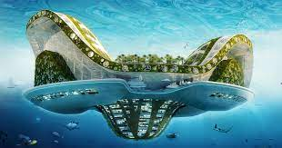
MINECRAFT CITY CHALLENGES: GROW MELBOURNE
Generate: Structures
Concept sketching: draw lots of quick ideas and annotate them to explain your concepts.
Generate new ideas for structures that could support new ways of growing food in cities.
Help Video: Generate

Slide 9
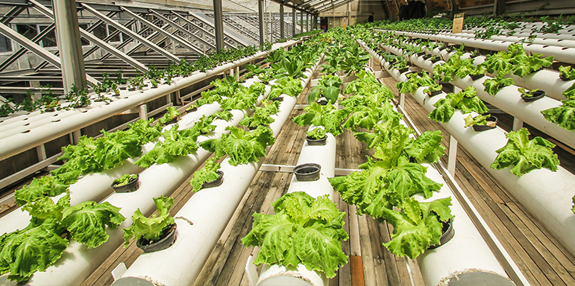
MINECRAFT CITY CHALLENGES: GROW MELBOURNE
Generate: City Farming
Concept sketching: draw lots of quick ideas and annotate them to explain your concepts.
Consider how food is grown in farms and generate ideas of how to recreate those conditions in a city environment.
Help Video: Generate

Slide 10
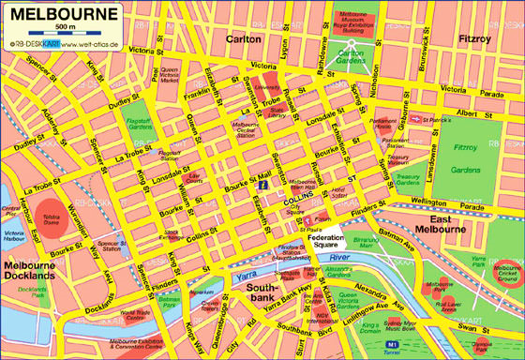
MINECRAFT CITY CHALLENGES: GROW MELBOURNE
Produce: Minecraft
Melbourne
Indicate blocks/streets most suitable for your designs
Explore Minecraft Melbourne and identify which area/s can be redesigned to best demonstrate your new ideas for improving Melbourne in the future.
Help Video: Produce

Slide 11
MINECRAFT CITY CHALLENGES: GROW MELBOURNE
Produce: Minecraft
Model
Screenshots of your Minecraft build
Take multiple screenshots and annotate them to best explain your new design for a futuristic and more sustainable Melbourne.
Help Video: Produce

Slide 12
MINECRAFT CITY CHALLENGES: GROW MELBOURNE
Produce: Minecraft
Model
Screenshots of your Minecraft build
Take multiple screenshots and annotate them to best explain your new design for a futuristic and more sustainable Melbourne.
Help Video: Produce

Slide 13
MINECRAFT CITY CHALLENGES: GROW MELBOURNE
Evaluate: Impacts of your design
What are the key innovations in your design?
What could be some of the negatives of your design?
Explain how the key elements of your design meet the requirements of the design brief and consider what some of the negative impacts of your design might be for some or all of the city residents.
How do these make the city more sustainable?
Help Video: Evaluate

Slide 14
MINECRAFT CITY CHALLENGES: GROW MELBOURNE
CRITERIA | APPROACHING THE LEVEL | AT THE LEVEL | BEYOND THE LEVEL
Investigate | Has investigated some suggested areas. | Has investigated all suggested areas. | Has thoroughly investigated all suggested areas.
Generate | Has generated some basic concepts. | Has generated a range of relevant concepts. | Has generated a range of detailed and insightful concepts.
Produce | Has produced a basic concept in Minecraft. | Has generated a suitable concept in Minecraft. | Has generated an innovative and creative concept in Minecraft.
Evaluate | Has evaluated basic elements of the design. | Has evaluated most elements of the design. | Has thoroughly evaluated all elements of the design.

