Slide 1
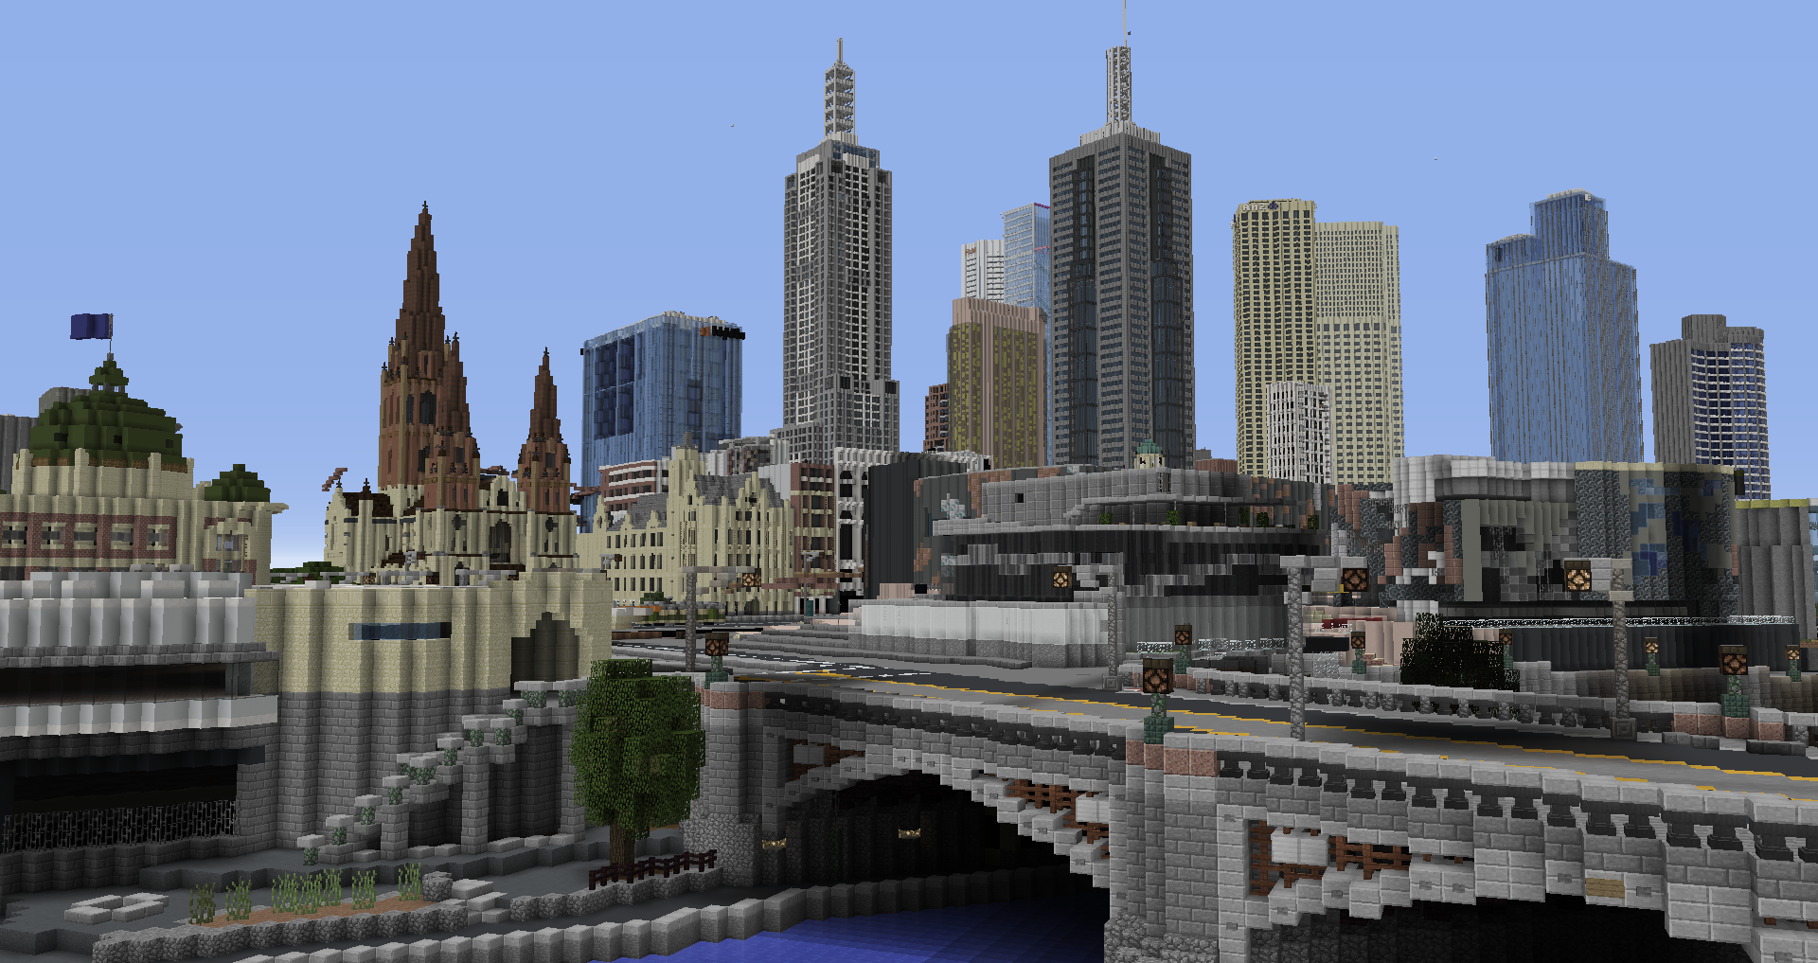
MINECRAFT CITY CHALLENGES: HEALTHY MELBOURNE
DESIGN
MELBOURNE
Team Name:
Team Members:

Slide 2
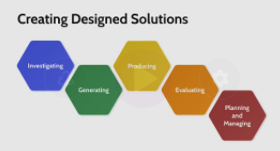
MINECRAFT CITY CHALLENGES: HEALTHY MELBOURNE
Design Brief
Read this design brief and identify key information in the space provided below.
Welcome to Healthy Melbourne - A Minecraft Mission!
As cities rapidly increase in population, we need to plan for new ways to ensure healthier and happier lives for the people who live in them.
One key issue that we need to solve is reducing mental and psychical health issues associated with modern life and work.
Through our experience with the recent pandemic, we now know how important daily exercise and social contact is to our wellbeing. We need to find more ways to encourage healthier and more sustainable habits.
We need your help to design Melbourne for a more sustainable future by creating new spaces, structures and technologies that will help to achieve this goal.
Key Information:
Help Video:
Planning and Managing

Slide 3
MINECRAFT CITY CHALLENGES: HEALTHY MELBOURNE
Explore the issues around health and wellbeing before looking into Solarpunk concepts that could help you to reshape part of Melbourne.
Generate a range of concepts for improving the health and wellbeing of the city inhabitants through the examples and ideas you discovered in your research.
Identify an area of Melbourne in the Minecraft map for your build. Modify existing structures and layouts to create your designed solution.
Take appropriate screenshots and add them, along with descriptive annotations, to your portfolio.
Seek ongoing feedback from your class, teacher and local school community.
Self-evaluate your Minecraft design and build in your portfolio. Identify pros and cons of your design if you implemented it in real life.
Help Video: Design Process

Slide 4
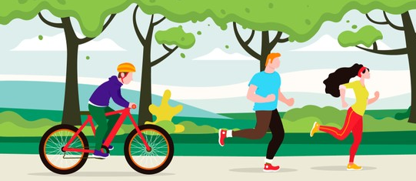
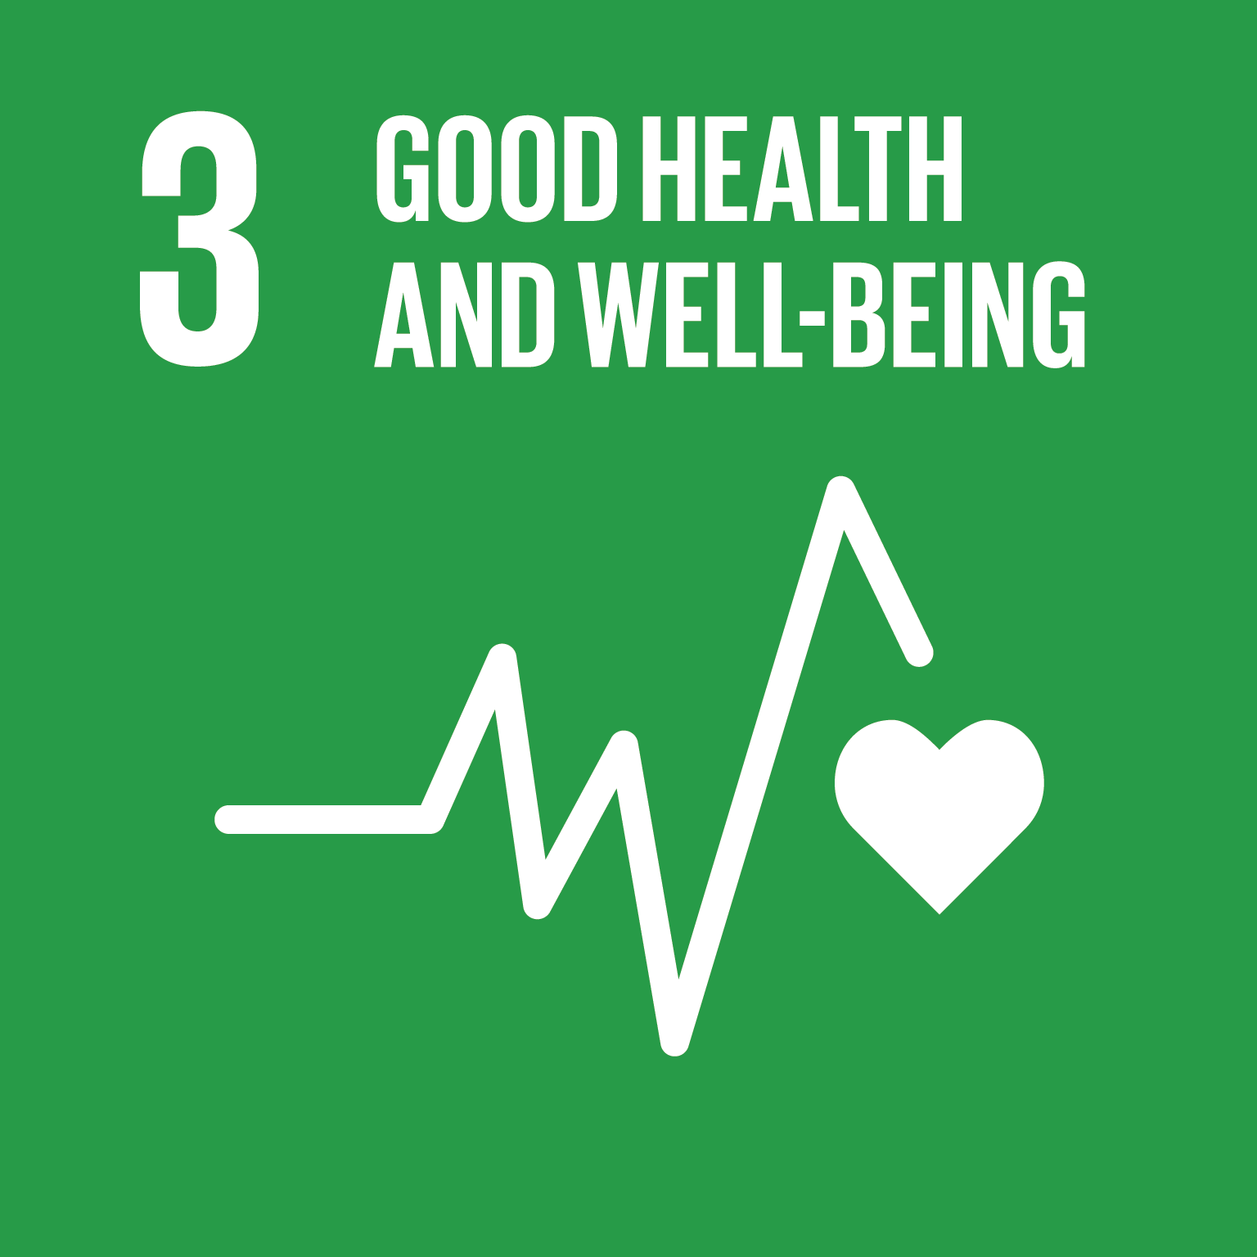
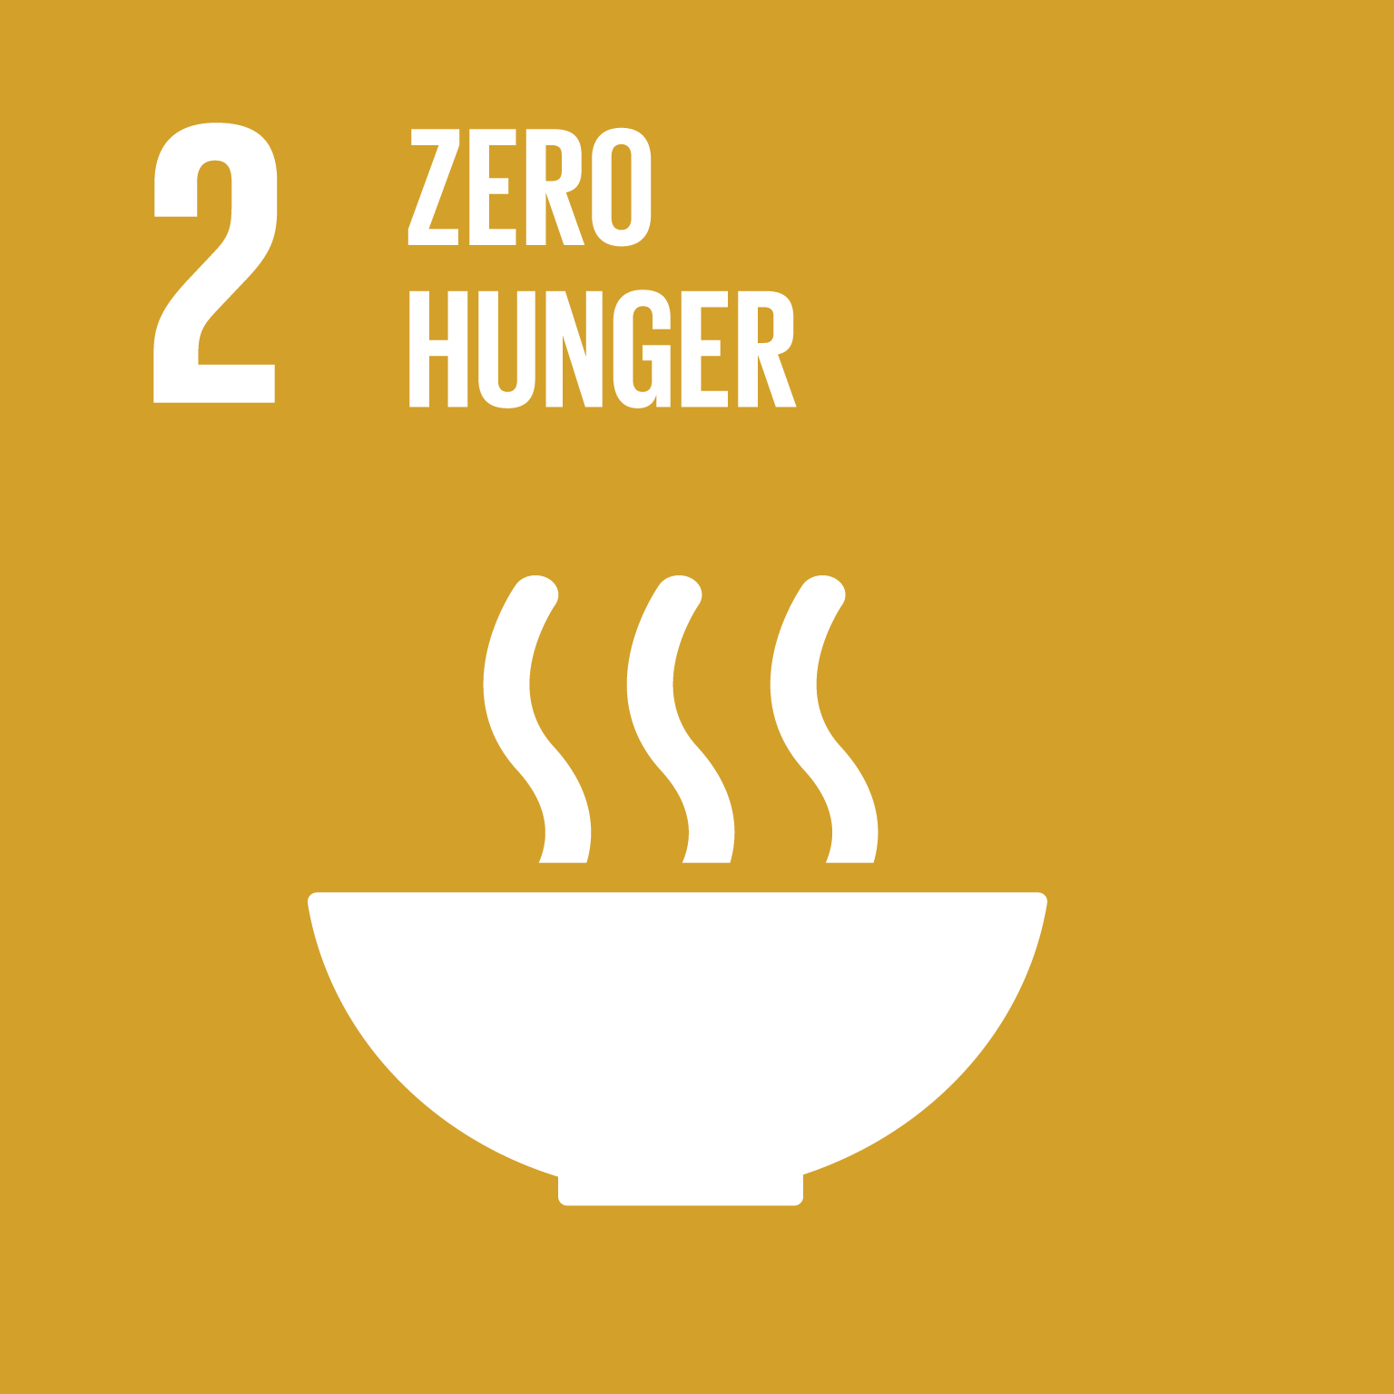
MINECRAFT CITY CHALLENGES: HEALTHY MELBOURNE
Investigate: Health and Wellbeing
How can cities be unhealthy places?
How can city living affect some people?
Research and unpack some of the current health and wellbeing issues around the world.
https://www.un.org/sustainabledevelopment/health/
https://www.healthline.com/health/mental-health/living-in-a-city#:~:text=Beyond%20stress%20Crowded%20city%20life,high%20blood%20pressure%2C%20and%20diabetes.

Slide 5
MINECRAFT CITY CHALLENGES: HEALTHY MELBOURNE
Investigate: Healthy City
What is a Healthy City?
3 Examples of Healthy City Activities
Find some examples of healthy activities that people can undertake.
Keywords Suggestions: exercise, nature, community
Help Video: Investigate

Slide 6
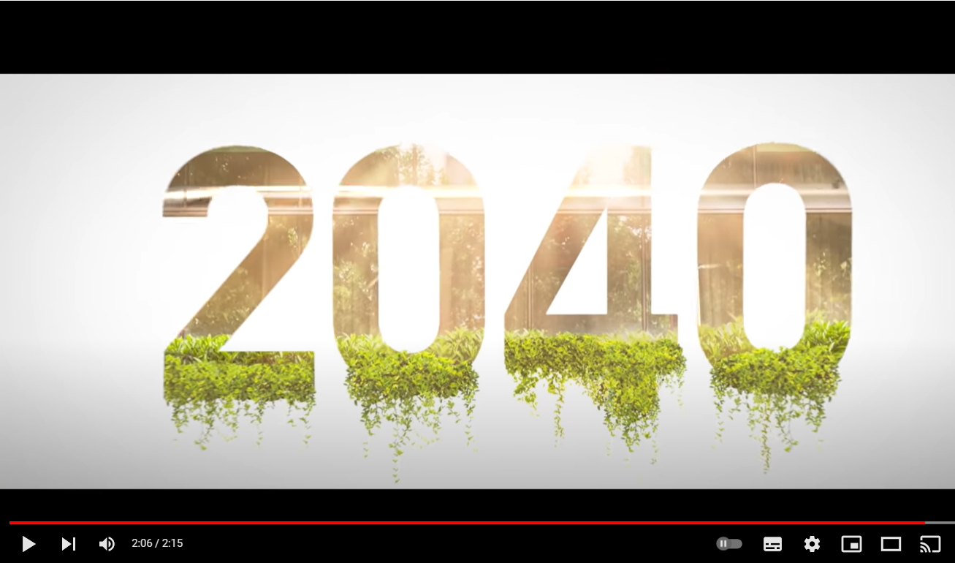
MINECRAFT CITY CHALLENGES: HEALTHY MELBOURNE
Investigate: Solarpunk
Elements of Solarpunk Cities
Explore the concept of Solarpunk and find some new ways of living in futuristic cities that is healthier and more sustainable.
2040 - Official Trailer
https://www.youtube.com/watch?v=p-rTQ443akE

Slide 7
MINECRAFT CITY CHALLENGES: HEALTHY MELBOURNE
Generate: Technologies
Concept sketching: draw lots of quick ideas and annotate them to explain your concepts.
Consider how innovative technologies could be used to improve health and wellbeing.
Help Video: Generate

Slide 8
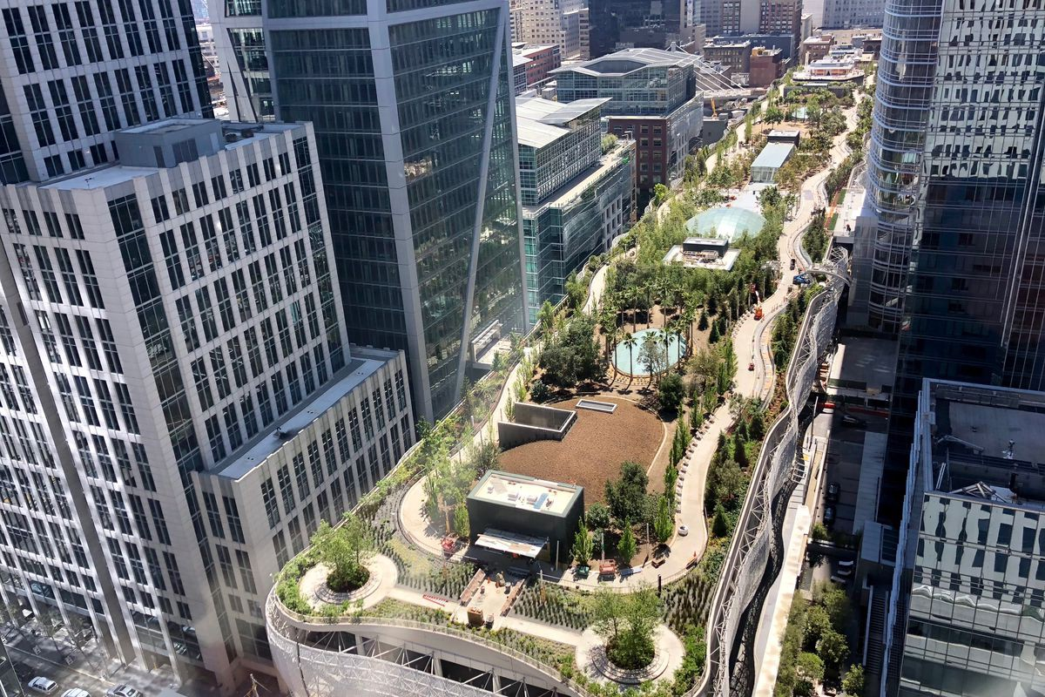
MINECRAFT CITY CHALLENGES: HEALTHY MELBOURNE
Generate: Structures
Concept sketching: draw lots of quick ideas and annotate them to explain your concepts.
Generate new ideas for structures that could support new ways of improving health and wellbeing
Help Video: Generate

Slide 9
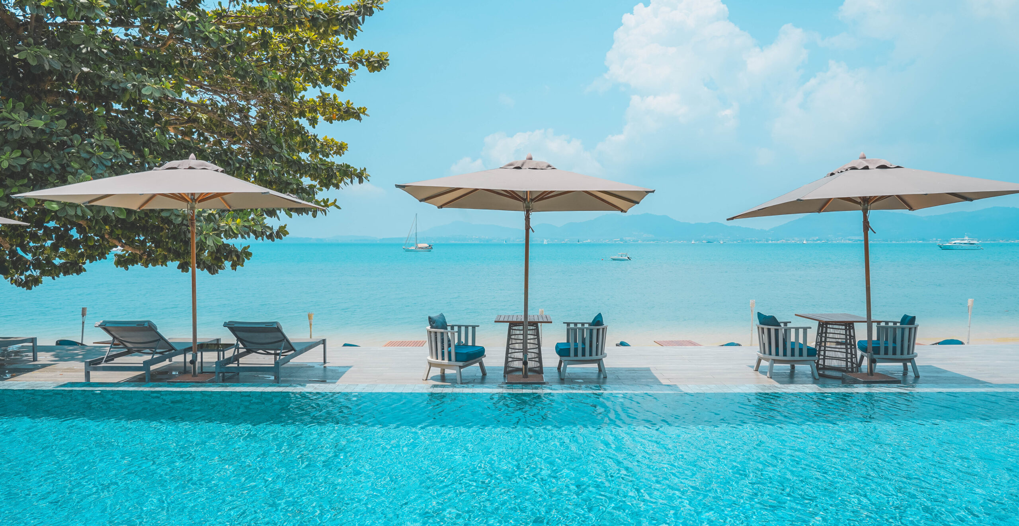
MINECRAFT CITY CHALLENGES: HEALTHY MELBOURNE
Generate: Nature
Concept sketching: draw lots of quick ideas and annotate them to explain your concepts.
Consider how health and wellbeing is focused on in other contexts.
Help Video: Generate

Slide 10
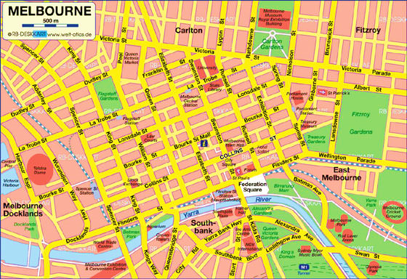
MINECRAFT CITY CHALLENGES: HEALTHY MELBOURNE
Produce: Minecraft
Melbourne
Indicate blocks/streets most suitable for your designs
Explore Minecraft Melbourne and identify which area/s can be redesigned to best demonstrate your new ideas for improving Melbourne in the future.
Help Video: Produce

Slide 11
MINECRAFT CITY CHALLENGES: HEALTHY MELBOURNE
Produce: Minecraft
Model
Screenshots of your Minecraft build
Take multiple screenshots and annotate them to best explain your new design for a futuristic and more sustainable Melbourne.
Help Video: Produce

Slide 12
MINECRAFT CITY CHALLENGES: HEALTHY MELBOURNE
Produce: Minecraft
Model
Screenshots of your Minecraft build continued
Take multiple screenshots and annotate them to best explain your new design for a futuristic and more sustainable Melbourne.
Help Video: Produce

Slide 13
MINECRAFT CITY CHALLENGES: HEALTHY MELBOURNE
Evaluate: Impacts of your design
Evaluate: Impacts of your design
What are the key innovations in your design?
What could be some of the negatives of your design?
Explain how the key elements of your design meet the requirements of the design brief and consider what some of the negative impacts of your design might be for some or all the city residents.
How do these make the city more sustainable?
Help Video: Evaluate

Slide 14
MINECRAFT CITY CHALLENGES: HEALTHY MELBOURNE
CRITERIA | APPROACHING THE LEVEL | AT THE LEVEL | BEYOND THE LEVEL
Investigate | Has investigated some suggested areas. | Has investigated all suggested areas. | Has thoroughly investigated all suggested areas.
Generate | Has generated some basic concepts. | Has generated a range of relevant concepts. | Has generated a range of detailed and insightful concepts.
Produce | Has produced a basic concept in Minecraft. | Has generated a suitable concept in Minecraft. | Has generated an innovative and creative concept in Minecraft.
Evaluate | Has evaluated basic elements of the design. | Has evaluated most elements of the design. | Has thoroughly evaluated all elements of the design.

